Slide 1
PDE4444
Week 2 Part 1: Supervised Learning and Linear Regression

Slide 2
Outline
Machine Learning
Linear Regression
- OLS
- Evaluation Metrics

Slide 3
Machine Learning
Supervised Learning
Unsupervised Learning

Slide 4
Recall-Machine Learning
The “field of study that gives computers the ability to learn without being explicitly programmed”.
The learning process improves the model by using training data.
The evolved model is used to make future predictions

Slide 5
Supervised Learning
Train by using labeled data and learn and predict new labels for unseen input data.
Classification is the task of predicting a discrete class label, such as “black, white, or gray” and “tumor or not tumor”.
Regression is the task of predicting a continuous quantity, such as “weight”, “probability”, and “cost”.

Slide 6
Unsupervised Learning
Detect patterns and relationships between data without using labeled data.
Clustering algorithms: Discover how to split the data set into a number of groups such that the data points in the same groups are more similar to each other compared to data points in other groups

Slide 7
Supervised Learning
True pattern
Noise

Slide 8
Supervised Learning
The main goal of supervised learning is study, build and use algorithms that can
learn from data to make predictions
What do we want to learn?
- We want to learn the true pattern hidden in the data and use it to make predictions.
- However, this true pattern is unknown, we have n observations (our dataset –
called training dataset).

Slide 9
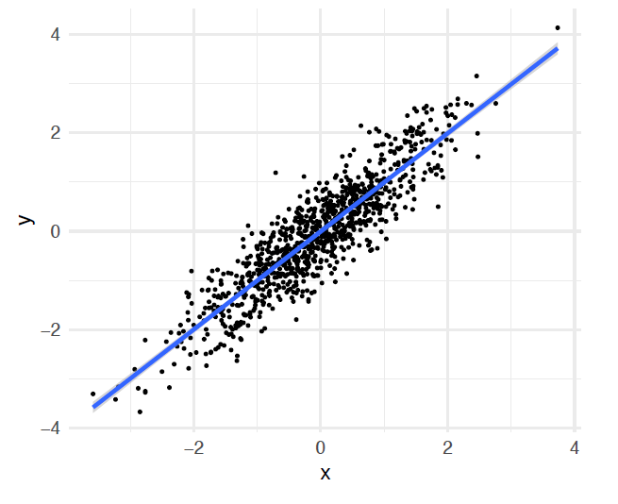
Supervised Learning
As an example, imagine to have the data on the right.
-We can use this data to learn the true pattern:
f(x) = x → True pattern
But we can see that the data contains also some noise (ε).
y = f(x) + ε

Slide 10
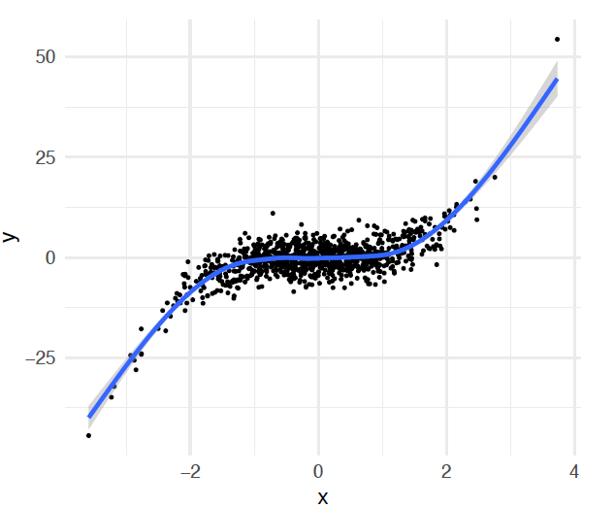
Supervised Learning
As an example, imagine to have the data on the right.
• We can use this data to learn the true pattern:
f(x) = x³ → true pattern
We can see that the data contains also some noise (ε).
y = f(x) + ε

Slide 11
Supervised Learning
Therefore, the dataset (n independent observations) always contains the following two components:
Data contains→ true pattern + noise
Goal of supervised learning is to use the available observations to learn the unknown true pattern so to create a model capable of making predictions on new unseen data.

Slide 12
Linear Regression
- OLS
- Accuracy

Slide 13
Linear Regression
Supervised Regression
It is used to establish a relationship between an input variable(X) (or more) and output variable(Y).
Input with single independent variable is mainly called as linear regression and input with more than one independent variable is called as multiple linear regression.
The input variables are the independent variables and output variable is the dependent variable

Slide 14
Linear Regression
Linear regression relies on the assumption that the hidden true pattern is linear.
Equation of the line: Y= b₀ + b₁.X
where b₁ is the slope of the line and b₀ is the intercept of Y and they are also called as weights.
Our end goal is to draw a line between X(independent) and Y(dependent) which fine tunes the relationship between them.

Slide 15
Linear Regression
Multiple Variables
Let's assume that our training data contains n independent observations, each observation has continuos dependen variable y and m continuos independen variables x1, ..., xm.
The true pattern f(x) = b₀ + b₁ x₁ + ... + b_{m} x_{m}
But remember that we also have noise:
Y = b₀ + b₁ x₁ + ... + b_{m} x_{m} + ε
linear Equation with multiple independent variables

Slide 16
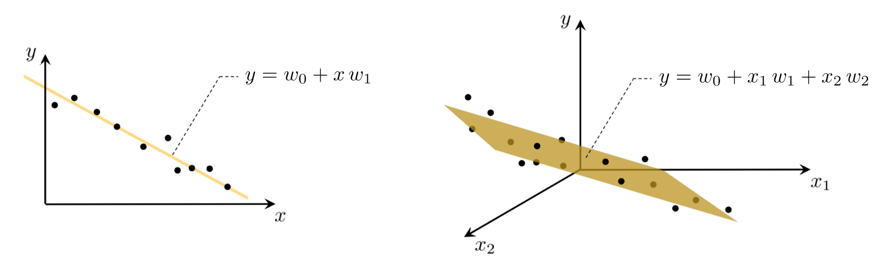

Linear Regression
Data for regression problems comes in the form of a set of input/output observation pairs
x is a vector of length m input variables
In this case the linear regression problem is analogously one of fitting a hyperplane to a scatter of points.
$$x= \left[x_{1}, x_{2}, x_{3}, …, x_{m}\right]$$

Slide 17
Linear Regression
Dataset with n observations
For n observations in the training data, we can write the set of linear equations:
y₁ = b₀ + b₁ x₁₁ + ... + b_{m} x_{1m} + ε1
...
y_{n} = b₀ + b₁ x_{n1} + ... + b_{m} x_{nm} + ε_{n}
Input variables X1 … Xm
Output variable Y
X11 X12 . . . X1m
.
.
.
Xn1 Xn2 . . . Xnm
y1
.
.
.
y_{n}
We need to infer the unknown parameters b₀ , b₁ ... b_{m}

Slide 18
Ordinary Least Squares (OLS)
To find the parameters of the hyperplane which best fits a regression dataset, it is common practice to first form the Least Squares cost function.
OLS is a technique to estimate the unknown parameters b₀ , b₁ ... b_{m} from a set of observations.
This method estimates the unknown parameters b₀ , b₁ ... b_{m} by finding the regression line minimizing the sum of squared errors.
In other words:
OLS finds the b₀ , b₁ ... b_{m} such that, SSE = Σ_{i}(ε_{i})² is minimum.
So, what is the error?

Slide 19
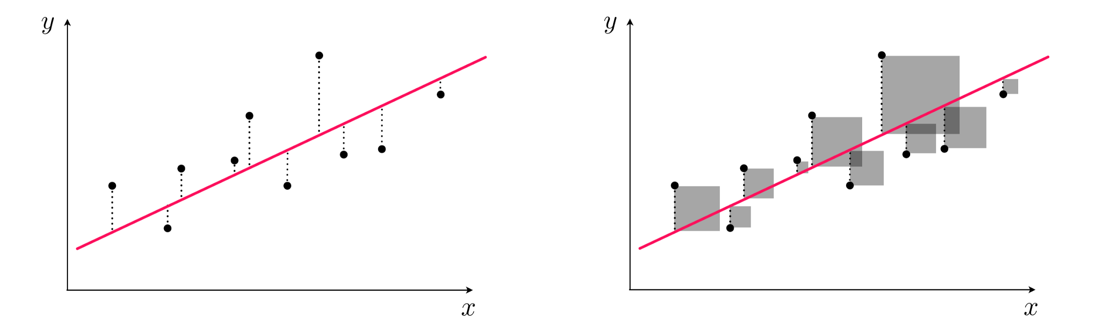
Error
Recall: A loss function (noise or error) is a measure of performance of a prediction model, in terms its ability to predict the expected outcome.
The output which is calculated based on the estimated parameters is called the predicted output Y’
The actual output Y is provided (supervised learning)
Based on this, the error is
The predicted output - The actual output
E = Y’ - Y
We need to minimize this value

Slide 20

The Least Squares cost function
One natural way to measure error between two quantities like this measure its square (so that both negative and positive errors are treating equally) as
Indeed, we want to tune our parameters to minimize the Least Squares cost.
Since the function is convex, the optimal value of can be found by equating the gradient to zero. (First order optimization)
$$SSE= \sum{E^{2}}$$

Slide 21
LOS Limitation
One downside of using the squared error in the Least Squares cost is that squaring the error increases the importance of larger errors.
This forces weights (coefficients) learned via the Least Squares cost to produce a linear fit that is especially focused on trying to minimize these large errors.
This is often due to outliers in a dataset.

Slide 22

Least Absolute Deviations cost function
As an alternative to using a squared error for our point-wise cost we can instead measure the absolute error as
By using absolute error instead of the squared, we still treat negative and positive errors equally.
$$SAE= \sum{\left|E\right|}$$

Slide 23
Absolute Error vs Squared Error

Slide 24
Linear Regression Example
Single variable:
If we want to predict the tip amount based on the bill amount.
Assume the following data, what is the possible predicted next tip amount?
Give estimation for Tip # 6
# | Tip $ | Bill $
1 | 10 | 100
2 | 5 | 50
3 | 20 | 220
4 | 7.5 | 90
5 | 12.5 | 150
6 | ?? | 40
0 5 10 15 20 25
Tips
0 40 80 120 160 200
Bill

Slide 25
Linear Regression
Single variable:
If we want to predict the tip amount based on the bill amount.
Assume the following data, what is the possible predicted next tip amount?
We can notice the relation here, data follow a line
# | Tip $ | Bill $
1 | 10 | 100
2 | 5 | 50
3 | 20 | 220
4 | 7.5 | 90
5 | 12.5 | 150
6 | ?? | 40
0 5 10 15 20 25
Tips
0 40 80 120 160 200
Bill

Slide 26
Linear Regression
Single variable:
If we want to predict the tip amount based on the bill amount.
Assume the following data, what is the possible predicted next tip amount?
Which regression line is the best?
# | Tip $ | Bill $
1 | 10 | 100
2 | 5 | 50
3 | 20 | 220
4 | 7.5 | 90
5 | 12.5 | 150
6 | ?? | 40
0 5 10 15 20 25
Tips
0 40 80 120 160 200
Bill

Slide 27
Linear Regression
Single variable:
If we want to predict the tip amount based on the bill amount.
Assume the following data, what is the possible predicted next tip amount?
Which regression line is the best?
The one with the minimum error
# | Tip $ | Bill $
1 | 10 | 100
2 | 5 | 50
3 | 20 | 220
4 | 7.5 | 90
5 | 12.5 | 150
6 | ?? | 40
0 5 10 15 20 25
Tips
0 40 80 120 160 200
Bill

Slide 28


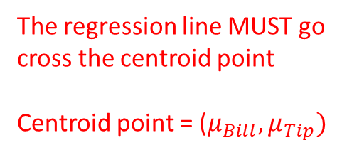
Linear Regression
Single variable:
If we want to predict the tip amount based on the bill amount.
Assume the following data, what is the possible predicted next tip amount?
$$μ_{Bill}=122$$
# | Tip $ | Bill $
1 | 10 | 100
2 | 5 | 50
3 | 20 | 220
4 | 7.5 | 90
5 | 12.5 | 150
6 | ?? | 40
Centroid
0 5 10 15 20 25
The regression line MUST go cross the centroid point
Centroid point = ($μ_{Bill}, μ_{Tip})$
$$μ_{Tip}=11$$
Tips
0 40 80 120 160 200
Bill

Slide 29

Linear Regression
Single variable:
If we want to predict the tip amount based on the bill amount.
Assume the following data, what is the possible predicted next tip amount?
$$μ_{Bill}=122$$
# | Tip $ | Bill $
1 | 10 | 100
2 | 5 | 50
3 | 20 | 220
4 | 7.5 | 90
5 | 12.5 | 150
6 | ?? | 40
0 5 10 15 20 25
$$Y′=0.386+0.087X$$
$$μ_{Tip}=11$$
Tips
0 40 80 120 160 200
Bill

Slide 30



Linear Regression
Single variable:
If we want to predict the tip amount based on the bill amount.
Assume the following data, what is the possible predicted next tip amount?
$$μ_{Bill}=122$$
# | Tip $ | Bill $
1 | 10 | 100
2 | 5 | 50
3 | 20 | 220
4 | 7.5 | 90
5 | 12.5 | 150
6 | ?? | 40
$$Y′=0.386+0.087X$$
0 5 10 15 20 25
$$Y^{′}=0.386+0.087∗40$$
$$Y′=3.866$$
$$μ_{Tip}=11$$
Tips
0 40 80 120 160 200
Bill

Slide 31
Linear Regression
Single variable:
If we want to predict the tip amount based on the bill amount.
Assume the following data, what is the possible predicted next tip amount?
$$μ_{Bill}=122$$
# | Tip $ | Bill $
1 | 10 | 100
2 | 5 | 50
3 | 20 | 220
4 | 7.5 | 90
5 | 12.5 | 150
6 | 3.866 | 40
$$Y′=0.386+0.087X$$
0 5 10 15 20 25
$$Y^{′}=0.386+0.087∗40$$
$$Y′=3.866$$
$$μ_{Tip}=11$$
Tips
0 40 80 120 160 200
Bill

Slide 32


Linear Regression
How our model fit to the given data?
Tips
Tips
$$Y′=0.386+0.087X$$
$$Y^{′}=11$$
# | Tip $ | Bill $
1 | 10 | 100
2 | 5 | 50
3 | 20 | 220
4 | 7.5 | 90
5 | 12.5 | 150
6 | ?? | 40
0 5 10 15 20 25
0 5 10 15 20 25
0 1 2 3 4 5 6
Bill
0 40 80 120 160 200
Bill

Slide 33
Linear Regression
How our model fit to the given data?
Find the error
# | Tip $ | Bill $
1 | 10 | 100
2 | 5 | 50
3 | 20 | 220
4 | 7.5 | 90
5 | 12.5 | 150
6 | ?? | 40
+0.45
0 5 10 15 20 25
+9
0 5 10 15 20 25
+1.5
+0.9
-0.93
Tips
-1
-6
-3.5
-0.26
-0.71
0 1 2 3 4 5 6
0 40 80 120 160 200
Bill

Slide 34
Accuracy of the model
Once we have successfully minimized the cost function for linear regression it is an easy matter to determine the quality of our regression model.
We must simply evaluate a cost function using our optimal weights.
The quality of a linear regression model is typically assessed using the following Evaluation metrics:
R-squared
MSE
MAE

Slide 35
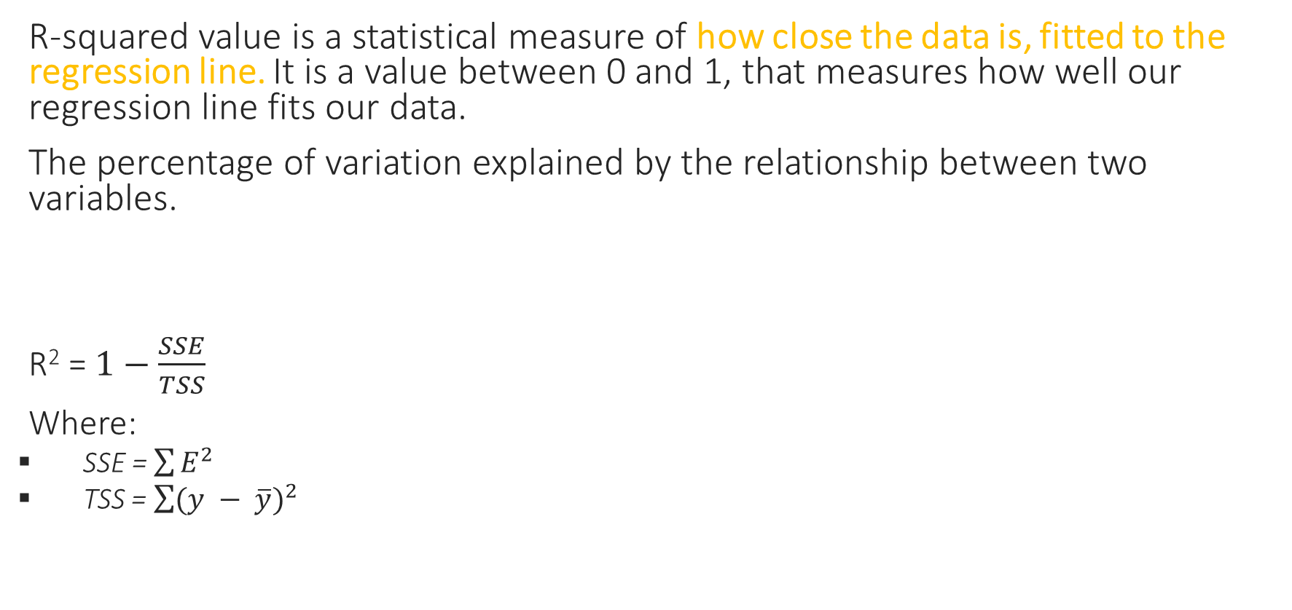
R-Squared
R-squared value is a statistical measure of how close the data is, fitted to the regression line. It is a value between 0 and 1, that measures how well our regression line fits our data.
The percentage of variation explained by the relationship between two variables.
R² = $1−\frac{SSE}{TSS}$
Where:
SSE = $\sum{E^{2}}$
TSS = $\sum{{(y − \overline{y})}^{2}}$

Slide 36
Linear Regression
What is SSE “ Sum Squared Error”
+9
81
81
+1.5
+
36
+
+
= 133.25
12.25
+
-1
36
12.25
-3.5
-6

Slide 37

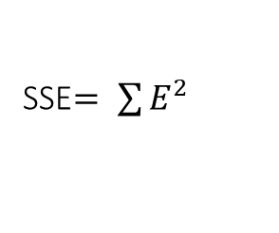

Linear Regression
SSE$= \sum{E^{2}}$
First regression model → $SSE=133.25$
Second regression model → $SSE=2.45$
+0.45
0 5 10 15 20 25
+9
0 5 10 15 20 25
+1.5
+0.9
-0.93
Tips
-1
-6
-3.5
+0.26
-0.71
0 1 2 3 4 5 6
0 40 80 120 160 200
Bill

Slide 38

Linear Regression
What is TSS “Total Squared Sum”
0 5 10 15 20 25
$$\overline{y}=11$$
0 40 80 120 160 200
Bill

Slide 39
Linear Regression
What is TSS “Total Squared Sum”
0 5 10 15 20 25
$$\overline{y}=11$$
0 40 80 120 160 200
Bill

Slide 40
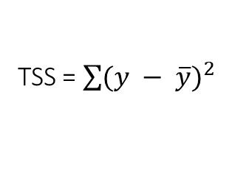
Linear Regression
TSS = $\sum{{(y − \overline{y})}^{2}}$
First model → TSS = 133.25
What is TSS “Total Squared Sum”
Second Model→ TSS = 133.25
81
0 5 10 15 20 25
81
+
36
+
+
= 133.25
12.25
+
36
12.25
$$\overline{y}=11$$
0 40 80 120 160 200
Bill

Slide 41

R-Squared
R² = $1−\frac{SSE}{TSS}$
^{First model →} R² = $1−\frac{133.25}{133.25}$ = 0
^{Second model →} R² = $1−\frac{2.45}{133.25}$ = 0.98
98% of the total sum of squares can be explained by using the estimated regression line to predict the tip.

Slide 42
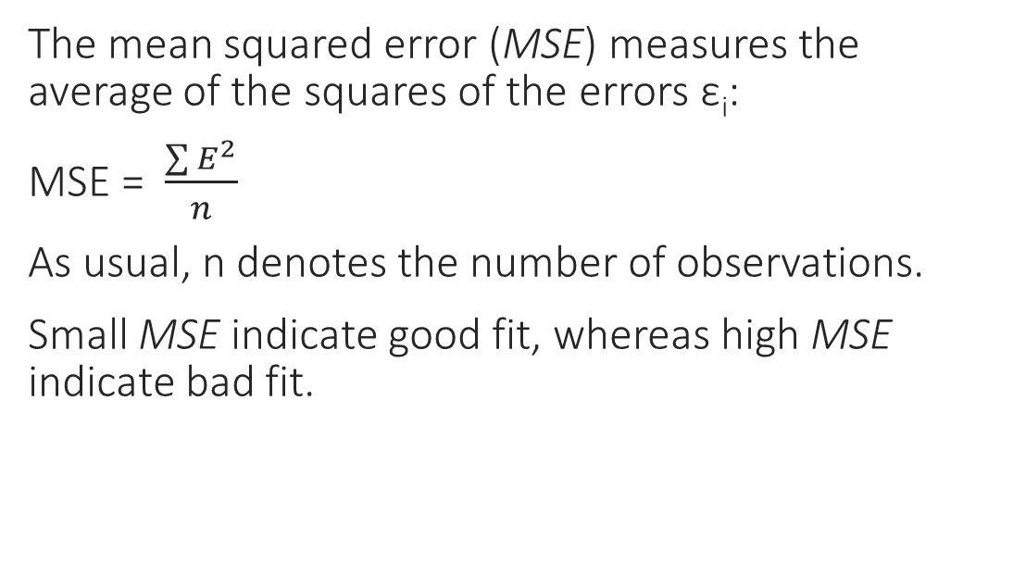
MSE
The mean squared error (MSE) measures the average of the squares of the errors ε_{i}:
MSE = $\frac{\sum{E^{2}}}{n}$
As usual, n denotes the number of observations.
Small MSE indicate good fit, whereas high MSE indicate bad fit.

Slide 43
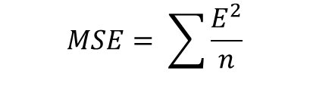


MSE
The mean squared error (MSE) measures the average of the squares of the errors ε_{i}:
MSE = $\frac{\sum{E^{2}}}{n}$
As usual, n denotes the number of observations.
Small MSE indicate good fit, whereas high MSE indicate bad fit.
$$MSE= \sum{\frac{E^{2}}{n}}$$
First regression model → $MSE=26.65$
Second regression model → $MSE=$0.49

Slide 44
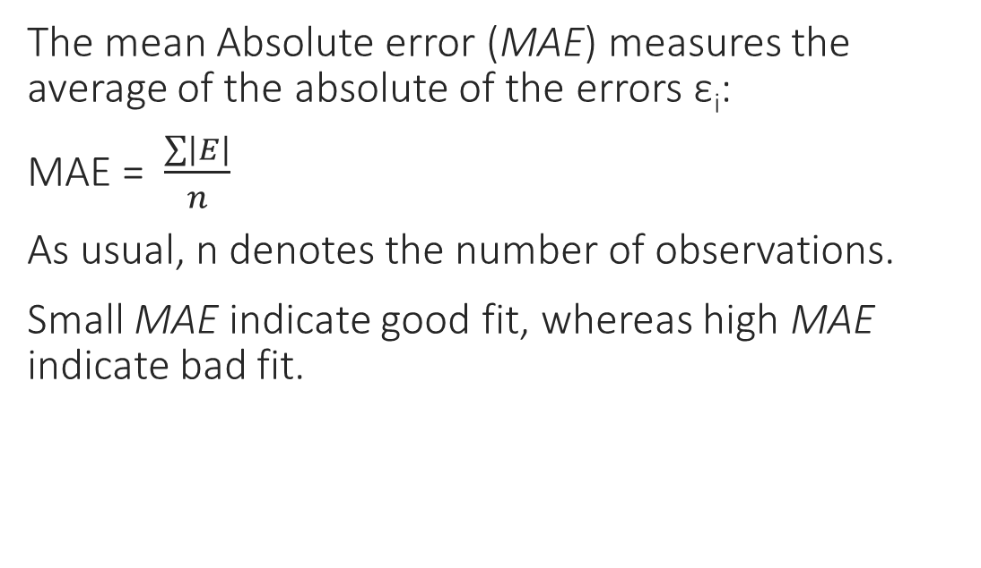
MAE
The mean Absolute error (MAE) measures the average of the absolute of the errors ε_{i}:
MAE = $\frac{\sum{\left|E\right|}}{n}$
As usual, n denotes the number of observations.
Small MAE indicate good fit, whereas high MAE indicate bad fit.

Slide 45
Weighted Regression
Imagine we have a linear regression dataset that contains multiple copies of the same point, which can occur in a variety of contexts including:
Experimental data (e.g., in physics, medicine, etc.): if a repeated experiment produces the same result.
In such instances 'duplicate' datapoints should not be thrown away, since they accurately represent the true phenomenon under study.
If we examine any regression cost function over such a dataset (i.e., one with repeated entries) we can see that it naturally collapses into a weighted version itself.

Slide 46

Weighted Regression
For example, let us examine the Least Squares cost of three samples and suppose that our first two datapoints and are identical.
In this instance, using the `model` notation, the first two summands of our cost function (in the first two datapoints) can be combined since they will always take on the same value.
$$SSE= \sum{E^{2}}$$
$$SSE={(model(x1,β)−y1)}^{2}+{(model(x1,β)−y1)}^{2}+ {(model(x3,β)−y3)}^{2}$$
$$SSE={2(model(x1,β)−y1)}^{2}+ {(model(x3,β)−y3)}^{2}$$

Slide 47
Weighted Regression
In general, this leads to the notion that each term in a regression cost can be weighted to reflect repeated points.
Weighted regression can also be employed when - given knowledge of the process generating a dataset - we want to weight each point based on our confidence of each datapoint.
The higher the weighting of this single point, the more we incentivize a linear regressor to fit to it.
If we increase its weight enough the fully trained regression model naturally starts fitting to this single datapoint alone (disregarding all other points).

